Slide 1
JOINs Dr Mariana Rocha School of Computer Science
CMPU 2007 Databases 1, Lecture 4

Slide 2
Learning Objectives
Learn how to import data from CSV files
Understand how to explore multiple tables using JOINS

Slide 3
Importing a CSV file
So far, we have been inserting data manually through the INSERT INTO command
We can also import existing data from a CSV file
Let’s create a database about football players and the clubs they play for.
The idea was to import the data from existing csv files and use SQL to retrieve data from these tables.

Slide 4
Create the database
First, we will create a schema called football. Once this is done, we right-click on the schema -> SQL Editor -> New SQL Script
Copy and paste the code presented in the file football.sql

Slide 5
Import the data
Once all tables are created, we can see them on the football schema (left menu in Dbeaver)
We should now right-click each table -> Import data
Select the csv file related to each table

Slide 6
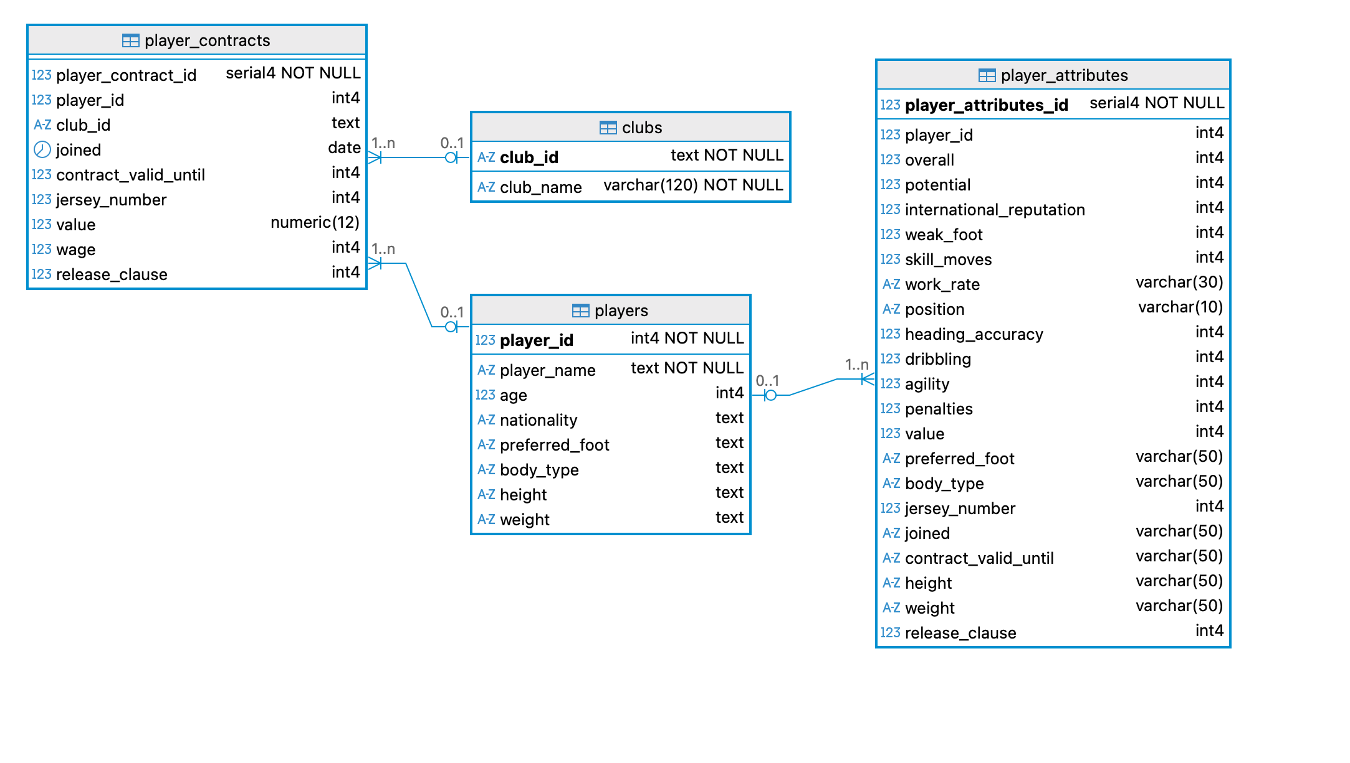
This database was created on Dbeaver and stores data imported from CSV datasets.

Slide 7
JOINS

Slide 8
JOINs
So far, in our queries, we have been looking at one table at a time.
But what if we want to get data from two tables in a single query?
In SQL, you often need to write queries that get data from two or more tables.
This is possible because the tables are connected through foreign keys.

Slide 9
Joins
A join is a query that combines data from two tables at once, linked together by a common value (foreign key).
The JOIN illustrates one of the major benefits of using a relational database.
It combines rows from two or more tables based on the related column they have

Slide 10
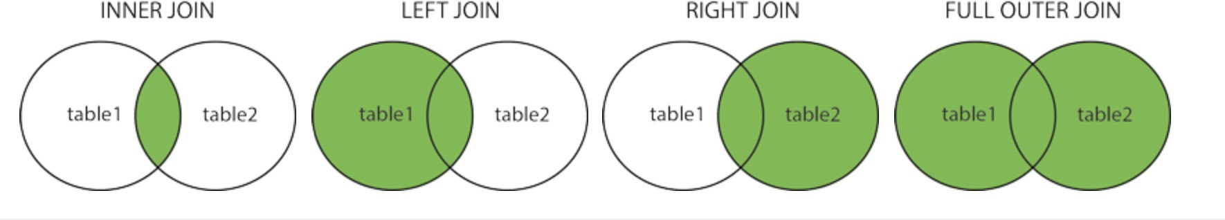
Joins
There are different types of joins, and they can be used depending on what data you want to retrieve.

Slide 11
INNER JOIN
This statement returns rows from both tables where matching values are found.
This type of join tells the DBMS you want to see all records in table1 and table2 where there is a record in both tables (matching records).
This makes sense for us because, due to the foreign key, we can trust the integrity of the data.
Inner Join syntax compares rows of table1 with table2 to check if anything matches based on the condition provided in the ON clause.

Slide 12
INNER JOIN - SYNTAX
The syntax is simple: the INNER JOIN is part of a select statement and includes the word JOIN and an ON (or USING) clause to determine what data the two tables have in common
As the INNER JOIN retrieves only the data the two tables have in common, the order of tables in the FROM…JOIN part does not matter
SELECT column_name(s) FROM table1 JOIN table2 ON table1.column_name = table2.column_name;

Slide 13
INNER JOIN – SYNTAX – Table Order
The order of the tables in an INNER JOIN does not affect which rows are returned because the INNER JOIN only returns rows that satisfy the join condition (the matching records)
PostgreSQL's optimiser is generally smart enough to reorder the joins internally to maximise performance, so in most cases, you don't need to worry about the order of the tables for performance reasons.
Be mindful about the order if you are using a different DBMS!

Slide 14
If we want to get data on the players (name, nationality, age) and their attributes (potential, weak foot), we need to use a JOIN, as this data is in two different tables. However, I only want data that is shared by both tables – if I have no info on a specific player, that player’s name, nationality and age won’t be retrieved).

Slide 15
-- Data on players with their attributes.
SELECT player_name,
nationality,
age,
potential,
weak_foot
FROM players
JOIN player_attributes
USING (player_id);
If we want to get data on the players (name, nationality, age) and their attributes (potential, weak foot), we need to use a JOIN, as this data is in two different tables. However, I only want data that is shared by both tables – if I have no info on a specific player, that player’s name, nationality and age won’t be retrieved).

Slide 16
INNER JOIN – SYNTAX – ON clause
In the previous example, we demonstrated the connection between the tables through the command USING, followed by the attribute that is available in both tables (player_id).
Another way to do it is through the ON clause. This is commonly used when the common data is allocated in attributes with different names.
-- Data on players with their attributes.
SELECT player_name, nationality, age, potential, weak_foot
FROM players
JOIN player_attributes
ON players.player_id = player_attributes.player_id

Slide 17
INNER JOIN – more than 2 tables
Suppose we need to retrieve data on player name, club name, wage, and overall rating. These attributes are located in 4 different tables.

Slide 18
INNER JOIN – more than 2 tables
SELECT
player_name, club_name, wage, overall
FROM players p
JOIN player_contracts pc
USING (player_id)
JOIN clubs c
USING (club_id)
JOIN player_attributes pa
USING (player_id)
ORDER BY pa.overall DESC;
Notice that we are performing a join between clubs and player_attributes, even though they are not directly connected. This is called a chained join and it happens when two tables don’t share a direct relationship, but you can connect them by “walking” through one or more intermediate tables.

Slide 19
INNER JOIN – Adding condition
We can also use the WHERE keyword to establish a certain condition. Let’s filter with WHERE to get only players earning more than 100k.:
SELECT
player_name,
wage
FROM players
JOIN player_contracts
USING (player_id)
WHERE wage > 100000;

Slide 20
INNER JOIN – Combining conditions
We can also combine the WHERE and ORDER BY conditions to retrieve data in a certain order:
SELECT
player_name,
wage
FROM players
JOIN player_contracts
USING (player_id)
WHERE wage > 100000
ORDER BY wage DESC;

Slide 21
INNER JOIN – Combining conditions
We can also combine the WHERE and LIKE conditions to retrieve specific data:
SELECT
player_name,
club_name
FROM players
JOIN player_contracts
USING (player_id)
JOIN clubs
USING (club_id)
WHERE player_name LIKE 'Crist%';

Slide 22
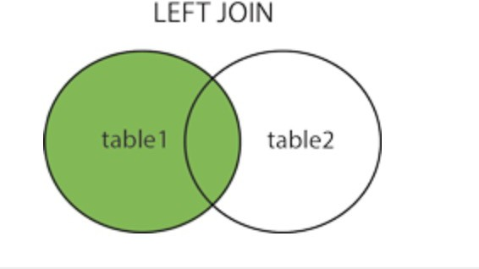
LEFT JOIN
The LEFT JOIN will always return all records from the left table, even when no matches are in the right table.
For records with no matching values in the right table, the output contains NULL values.
22

Slide 23
LEFT JOIN
SELECT count(player_id) FROM players LEFT JOIN player_contracts USING(player_id) WHERE wage IS NULL;
1,553 players in our database have no contract. I can see that doing a left join between players and players_ contracts.
23

Slide 24
LEFT JOIN
SELECT
player_id,
player_name,
wage
FROM players
LEFT JOIN player_contracts
USING (player_id) ORDER BY wage DESC;
24

Slide 25
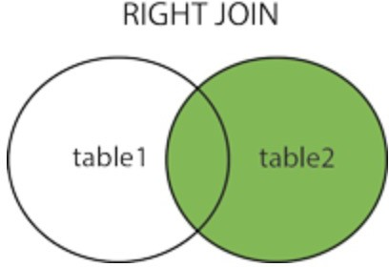
RIGHT JOIN
The RIGHT JOIN will always return all records from the right table, even when there are no matches in the left table.
For records with no matching values in the left table, the output contains NULL values.

Slide 26
RIGHT JOIN
SELECT count(player_id) FROM player_attributes RIGHT JOIN players USING(player_id) WHERE weak_foot IS NULL;
441 players in our database have no info on the table player_attributes.
26

Slide 27
RIGHT JOIN
SELECT player_id, player_name, weak_foot
FROM player_attributes
RIGHT JOIN players
USING (player_id)
ORDER BY weak_foot DESC;
27

Slide 28

28

